Slide 1


Diabetic retinopathy among Aboriginal and
Torres Strait Islander people
Key facts
Information to assist health care providers in their everyday practice

Slide 2



These key facts have been developed by the
Australian Indigenous HeathInfoNet (www.healthinfonet.ecu.edu.au)
and The Fred Hollows Foundation.
They aim to provide information for people working, studying or interested in Aboriginal and Torres Strait Islander eye health.
In particular, they aim to provide information that will
assist health care providers in their everyday practice.
Health workforce
Students
General public

Slide 3
Contents
Points to remember
How does diabetic retinopathy (DR) occur?
Who gets DR?
How to prevent vision loss from DR
How to detect DR
How to treat DR
Delivering eye care for DR
More information about eye care
The Eye Health web resource
Contact details

Slide 4
Points to remember
Diabetic retinopathy (DR):
Is a serious eye problem that can lead to vision loss and blindness in people with diabetes.
Remember
DR can damage the eye before people know they have diabetes or experience any vision problems

Slide 5
Points to remember
The good news is:
Up to 98% of severe vision loss and blindness from DR can be prevented if people receive recommended eye checks and treatment.
Aboriginal and Torres Strait Islander people with diabetes are now more likely to receive yearly eye checks than in the past and are less likely to experience vision loss due to DR.
Good news
More people are receiving yearly eye checks and less are experiencing vision loss from DR

Slide 6
Points to remember
But despite signs of progress:
Aboriginal and Torres Strait Islander people are still at greater risk of developing diabetes and DR than non-Indigenous people.
For Aboriginal and Torres Strait Islander people with diabetes, only half will have received their last yearly eye check for DR, and a quarter will never have had one.
Don’t forget
Half of all Aboriginal and Torres Strait Islander patients will not have received their last yearly eye check

Slide 7
Points to remember
Now it is important that:
Aboriginal and Torres Strait Islander people are supported to manage their diabetes and get yearly eye checks so that DR is detected early.
Yearly eye checks include: a medical history, vision test, retinal examination, and referral if specialist eye care is needed.
People with DR are given information about eye care pathways and are supported to seek specialist treatment at the right time.
Important
People need support to manage their diabetes and get yearly eye checks

Slide 8
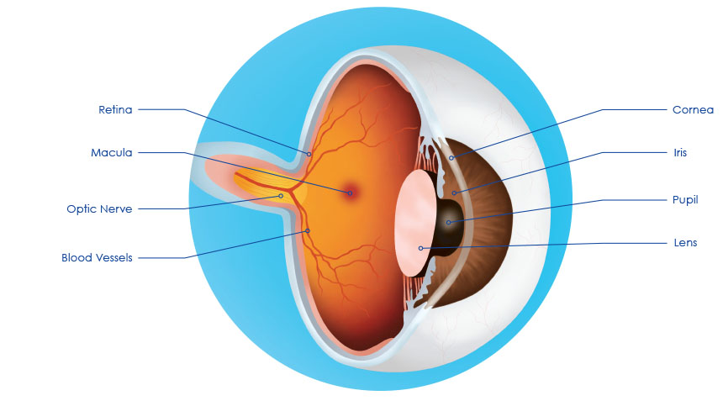
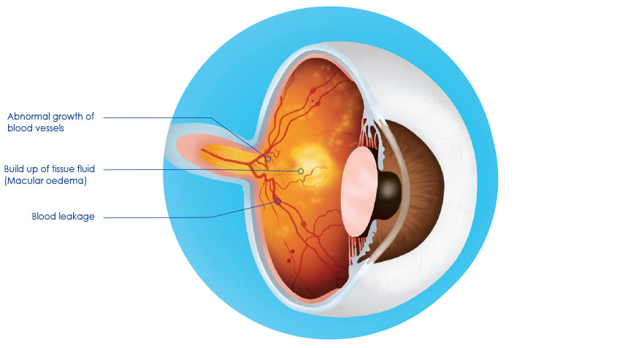
How does diabetic retinopathy occur?
DR occurs when chronic high blood sugar levels result in changes in blood flow that damage small blood vessels in the retina of the eye. The blood vessels can leak and bleed, abnormal blood vessels can grow, and retinal detachment can occur.
Retina
Cornea
Abnormal growth of blood vessels
Macula
Iris
Build up of tissue fluid
(Macular oedema)
Optic nerve
Pupil
Blood vessels
Lens
Blood leakage
Normal retina
Diabetic retinopathy
Source: Indigenous Eye Health

Slide 9
How does diabetic retinopathy occur?
DR usually affects both eyes and progresses over time through the early (non-proliferative) stages to the late (proliferative) stage when severe vision loss can occur.
The early stages of DR are usually asymptomatic
(have no symptoms)

Slide 10
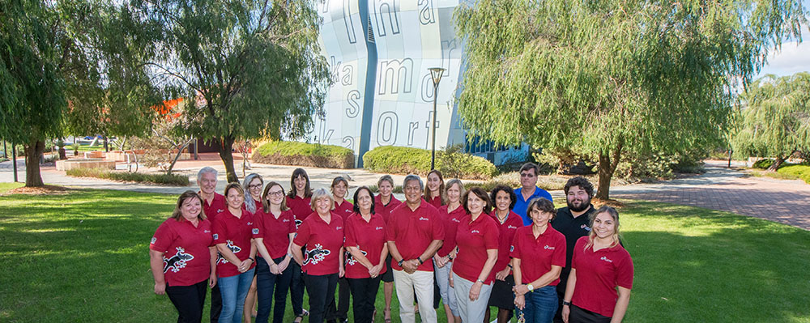

How does diabetic retinopathy occur?
When symptoms of vision loss occur they include: spots, floaters, blank areas or dark areas in the visual field.
DR can lead to an eye condition called diabetic macular oedema that can cause blurry vision at any stage of DR.
Normal vision
Vision loss with spots
For more info: Diabetes eye health: a guide for health care professionals (International Diabetes Federation and The Fred Hollows Foundation, 2015)
Australian Indigenous HealthInfoNet, Kurongkurl Katitjin, Edith Cowan University, WA

Slide 11
Who gets diabetic retinopathy?
All people with type 1 and type 2 diabetes are at risk of developing DR and the longer they have diabetes the greater the risk.
People with poorly controlled blood sugar, blood pressure and cholesterol levels are more likely to develop DR.
Aboriginal and Torres Strait Islander people are three times more likely to have diabetes, which puts them at greater risk of developing DR.
Aboriginal and Torres Strait Islander adults with diabetes are
2x
as likely to have vision impairment from DR as non-Indigenous adults with diabetes.¹
For more stats: The National Eye Health Survey 2016 report (Foreman, et al., 2016)
1. Based on crude figures for Indigenous adults aged 40 years and over and non-Indigenous adults aged 50 years and over.

Slide 12
How to prevent vision loss from diabetic retinopathy
Up to
98%
of severe vision loss from DR can be prevented by detecting DR early and treating it at the right time.²
Aboriginal and Torres Strait Islander people with diabetes need support to manage their diabetes and get yearly eye checks so that DR is detected early and treated at the right time.
2. Taylor HR, National Indigenous Eye Health Survey Team (2009) National Indigenous eye health survey: minum barreng (tracking eyes): summary report. Melbourne: Indigenous Eye Health Unit, The University of Melbourne

Slide 13




How to prevent vision loss from diabetic retinopathy
People with diabetes need:
  education and lifestyle advice to encourage healthy eating habits and regular exercise
  an eye check when diabetes is diagnosed and regular eye checks afterwards
  medication, if prescribed by a medical practitioner, to control blood sugar, blood pressure and blood cholesterol levels
  early detection of DR and treatment at the right time.
Communities need education about DR.
healthy eating
regular exercise
prescribed medication
regular eye checks
For more info: Diabetes eye health: a guide for health care professionals (International Diabetes Federation and The Fred Hollows Foundation, 2015)

Slide 14
How to detect diabetic retinopathy
NHMRC guidelines recommend that Aboriginal and Torres Strait Islander people with diabetes have an eye check every year (eye checks for non-Indigenous people are recommended every two years).
There are no symptoms in the early stages of DR, so regular eye checks are needed for detection before it progresses to a stage when serious vision loss and blindness can occur.
As DR progresses and damage to the retina increases, people may need to have their eyes checked more often.
Yearly eye checks are needed for early detection of DR

Slide 15
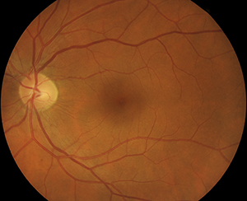
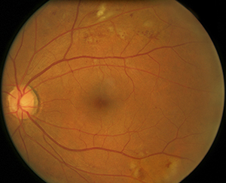
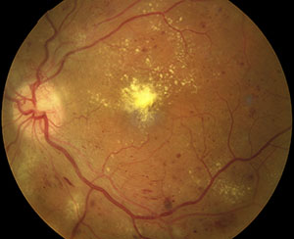
How to detect diabetic retinopathy
Retinal examinations can be carried out by a health worker, nurse or doctor in a primary health care setting if there is a special digital camera available that takes photographs of the retina.
Retinal examinations can also be carried out by eye specialists (optometrists or ophthalmologists) using a digital camera, ophthalmoscope or slit-lamp.
Images of the retina
Normal
Abnormal
For info about DR screening: Check Today, See Tomorrow: diabetic retinopathy screening card (Indigenous Eye Health Unit, 2015)
Sight-threatening
Source: Indigenous Eye Health

Slide 16
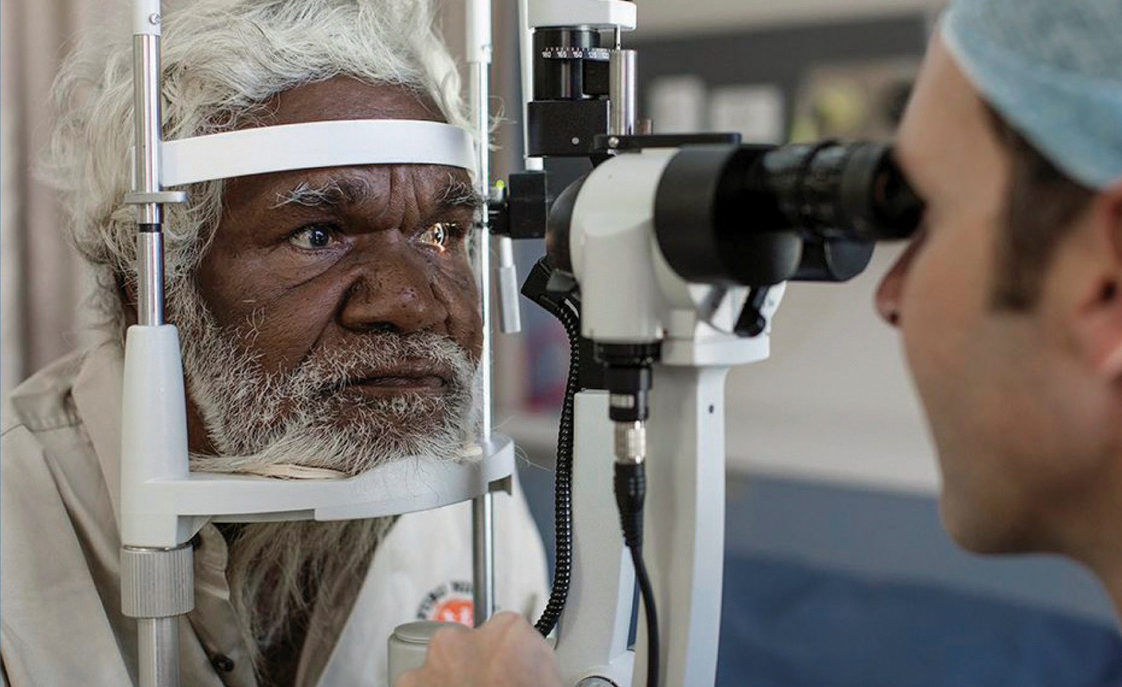
How to treat diabetic retinopathy
At all stages of DR, people need to manage their diabetes and get regular eye checks.
During the early stages of DR, no treatment is needed unless diabetic macular oedema occurs.
Laser treatment (photocoagulation) is the main form of treatment when DR progresses.
If a person has already lost sight from DR, laser treatment will only help to maintain the sight that is left—it cannot restore lost sight.
Source: Lions Outback Vision

Slide 17
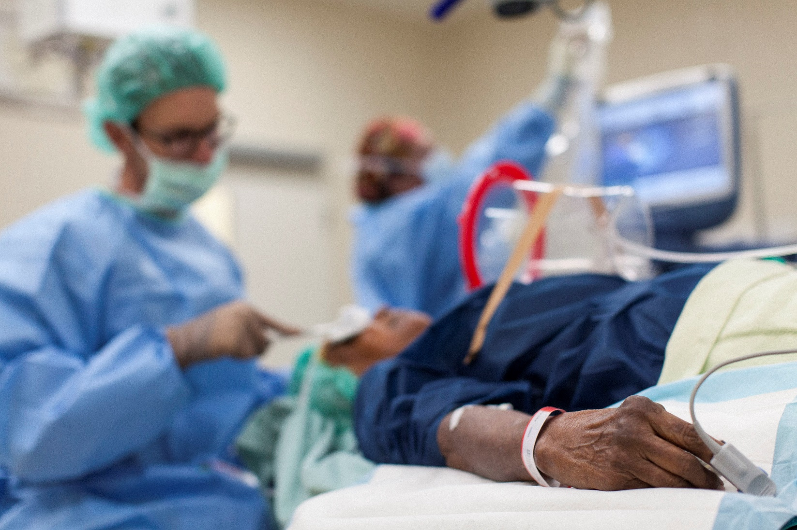
How to treat diabetic retinopathy
Complicated cases of DR may need eye surgery (vitrectomy).
Injection of medication into the eye (intravitreal injection of anti-VEGF medication) is a relatively new treatment option for some cases.
For more info: Diabetes eye health: a guide for health care professionals (International Diabetes Federation and The Fred Hollows Foundation, 2015)
Source: The Fred Hollows Foundation

Slide 18
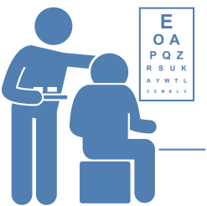

Delivering eye care for diabetic retinopathy
Primary health care can support patients to manage their diabetes and access care for their eyes by:
  incorporating yearly eye checks into patient management plans
  establishing a patient recall system to identify and remind all diabetes patients about their yearly eye checks
  conducting eye checks (or referring patients to an eye specialist to have one)

Slide 19
Delivering eye care for diabetic retinopathy
Primary health care can support patients to manage their diabetes and access care for their eyes by:
  referring patients with DR or vision impairment to an eye specialist for further assessment and management
  supporting patients after referral to: make appointments, complete treatment, and attend appointments for follow-up and review
  providing information about eye care pathways to help people with DR get specialist care when they need it.
Ophthalmology services
Ophthalmologists
Outreach services
General practitioners
Optometry services
Community controlled health services
Aboriginal and Torres Strait Islander Health Practitioners
Nurses
Optometrists
Diabetes educators
Hospitals
Aboriginal and Torres Strait Islander Health Workers
Private practices
GP clinics

Slide 20
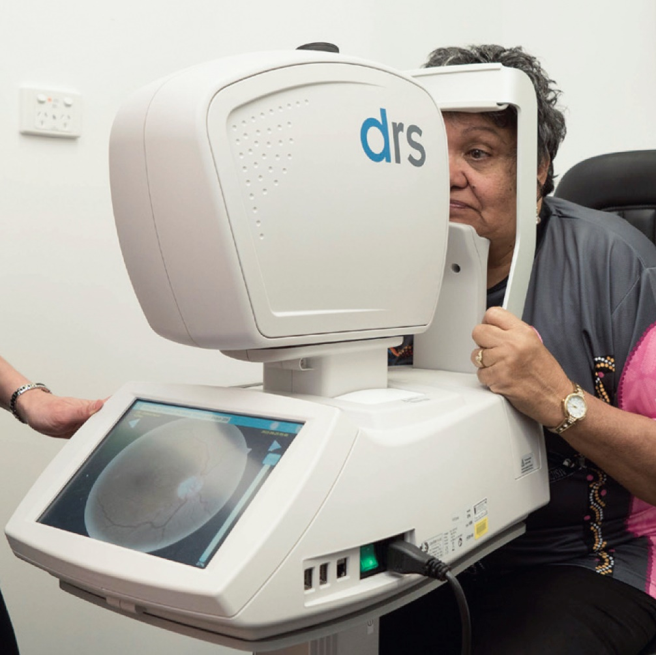
Delivering eye care for diabetic retinopathy
Since 1 November 2016, primary health care services have had access to an Aboriginal and Torres Strait Islander specific MBS item (12325) to support screening for DR using a retinal camera.
MBS item 12325 is now available for yearly retinal examinations
Source: Indigenous Eye Health

Slide 21
Delivering eye care for diabetic retinopathy
The Integrated Team Care (ITC) Program helps Aboriginal and Torres Strait Islander people access culturally appropriate primary health care and provides care coordination services to people who need multidisciplinary care for chronic disease, including DR.
Outreach optometry and ophthalmology services are delivered to people living in regional, rural and remote areas through the Visiting Optometrists Scheme (VOS) and the Rural Health Outreach Fund (RHOF).
Integrated Team Care (ITC) Program
Rural Health Outreach Fund (RHOF)
Visiting Optometrists Scheme (VOS)

Slide 22
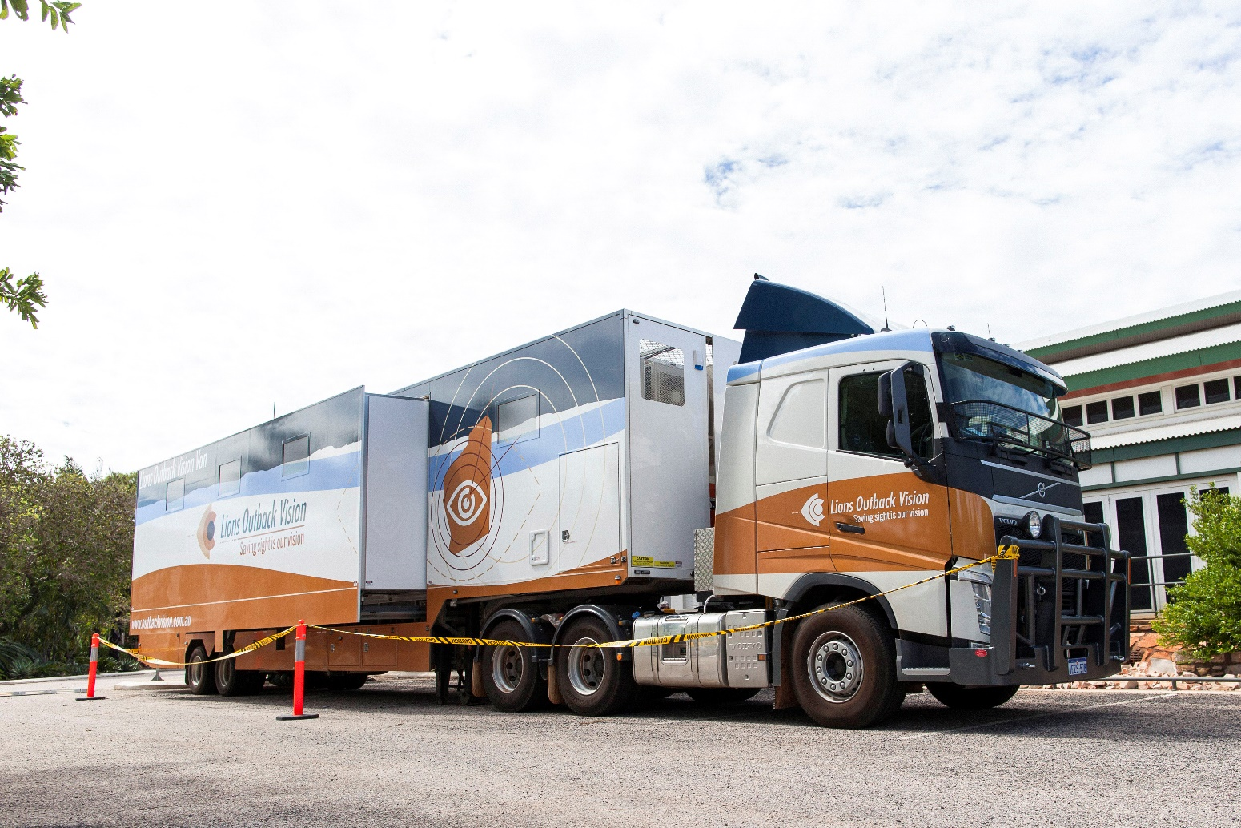
Delivering eye care for diabetic retinopathy
Fully equipped vans—like the Lions Outback Vision Van in Western Australia and the IDEAS Van in Queensland—give rural and remote Australians access to specialist eye care. The vans are a mobile treatment centre offering comprehensive optometry and ophthalmology care, including the treatment of DR.
Source: The Fred Hollows Foundation

Slide 23
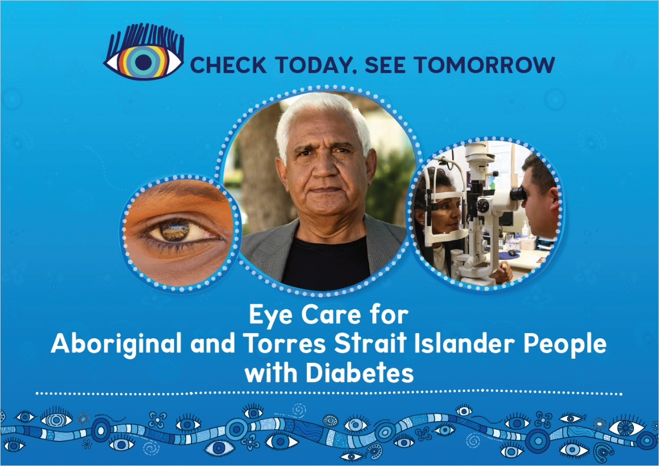
More information about eye care for diabetic retinopathy
Health practice resources
Check Today, See Tomorrow [resource kit] (Indigenous Eye Health Unit, 2015).
Resources for health professionals include:
  Diabetes eye care flipchart
  Messages and adult eye check
  Diabetic retinopathy screening card
Source: Indigenous Eye Health

Slide 24
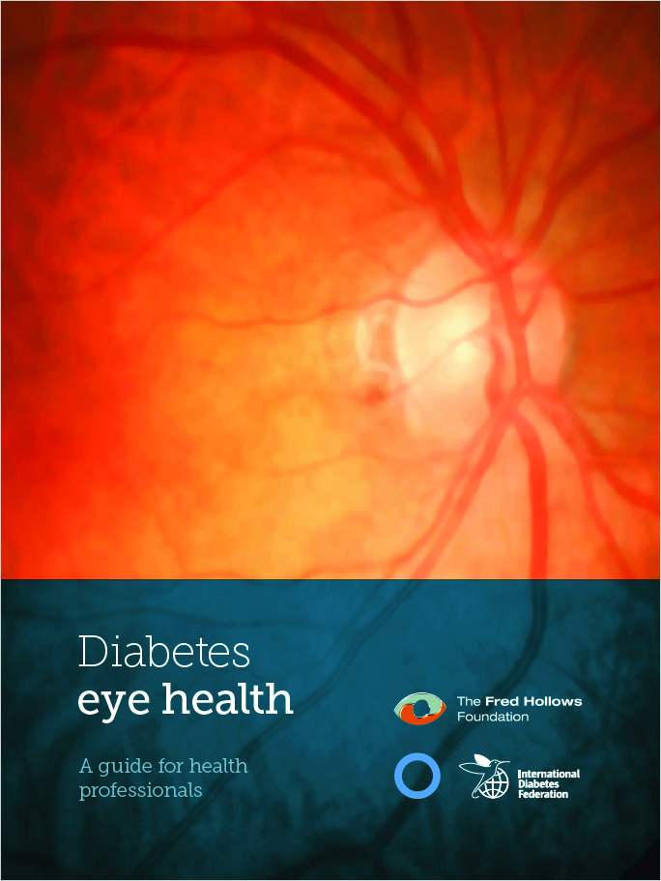
More information about eye care for diabetic retinopathy
Health practice resources
Diabetes eye health: a guide for health care professionals [report] (International Diabetes Federation and The Fred Hollows Foundation, 2015)
Guidelines for the management of diabetic retinopathy [report] (National Health and Medical Research Council, 2008)
Source: The Fred Hollows Foundation

Slide 25
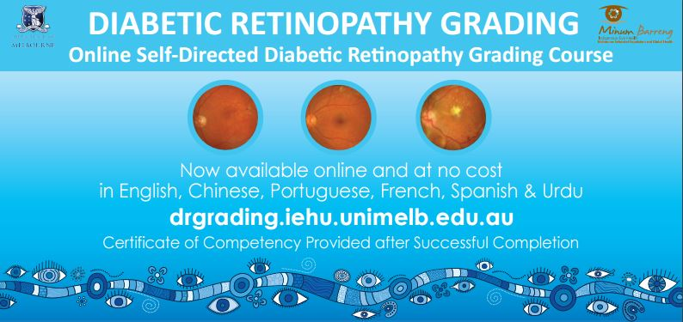
More information about eye care for diabetic retinopathy
Training resources
Diabetic retinopathy grading [online course] (Indigenous Eye Health Unit and Centre for Eye Research Australia, updated 2016).
Eye health and diabetes [online module] (Remote Area Health Corps)
Primary eye care checks [online module] (Remote Area Health Corps)
Source: Indigenous Eye Health

Slide 26
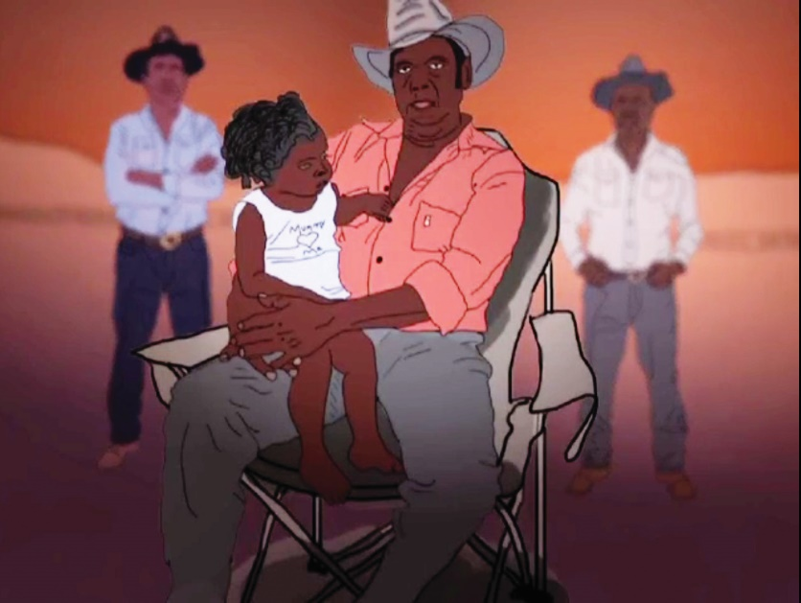
More information about eye care for diabetic retinopathy
Health promotion resources
Aunty Mary’s story [video] (Guide Dogs NSW/ACT, Hooker M, 2013 )
Bad sugars, bad eyes [video] (Lions Outback Vision, 2012)
Check Today, See Tomorrow [resource kit]
(Indigenous Eye Health Unit, 2015).
Resources for patients and communities include:
  Diabetes eye care brochure
  Urban, rural and remote posters
  Multimedia resources
Source: Lions Outback Vision

Slide 27
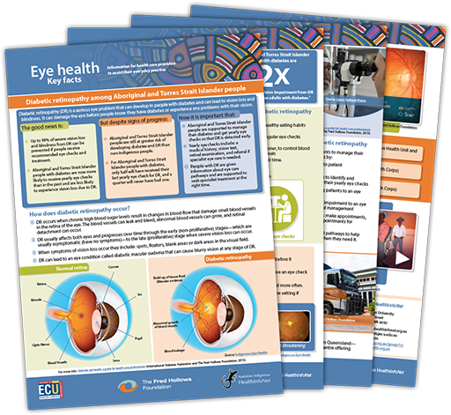
The Eye Health web resource
These key facts have been developed by the Australian Indigenous HealthInfoNet
and The Fred Hollows Foundation
and are available on the HealthInfoNet’s
Eye Health web resource:
www.healthinfonet.ecu.edu.au/other-health-conditions/eyeworkers/diabetic-retinopathy/key-facts

Slide 28
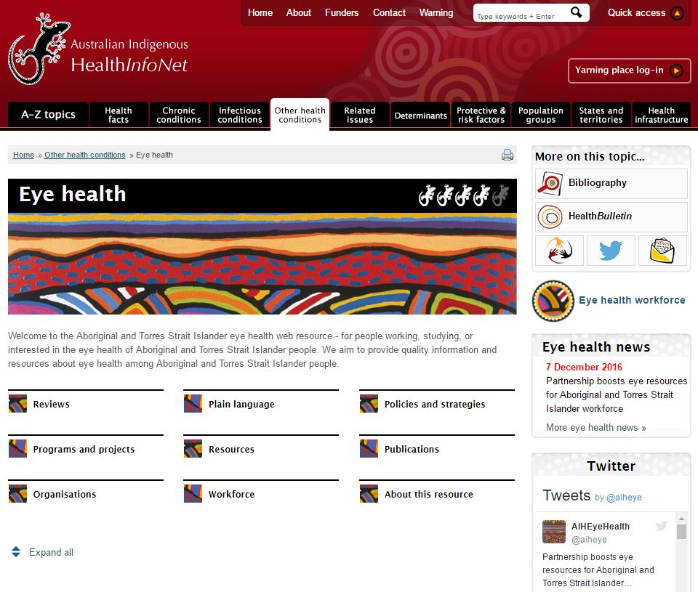
The Eye Health web resource
The Eye Health web resource (www.eyehealth.org.au) provides health professionals with the latest information and research to inform their everyday practice. It includes:
  an extensive collection of information and resources about the eye health of Aboriginal and Torres Strait Islander people
  a workforce portal (a selection of plain language information for health care providers)
  a yarning place (an online network to help people connect).
Home page of the Eye Health web resource

Slide 29





The Eye Health web resource
The health workforce is encouraged to contribute to the development
of the Eye Health web resource by
sharing knowledge and experience
and suggesting new materials for inclusion:
www.healthinfonet.ecu.edu.au/contact/share_info
Publications
Health promotion
resources
Health practice
resources
Programs and
projects
Job opportunities

Slide 30

Contact details
Australian Indigenous HealthInfoNet
Address: Edith Cowan University
2 Bradford Street
Mt Lawley WA 6050
Eye health email: eyehealth@healthinfonet.org.au
General email: healthinfonet@ecu.edu.au
Phone: (08) 9370 6336
Yarning place: www.yarning.org.au/group/12
Website: www.eyehealth.org.au

